Slide 1
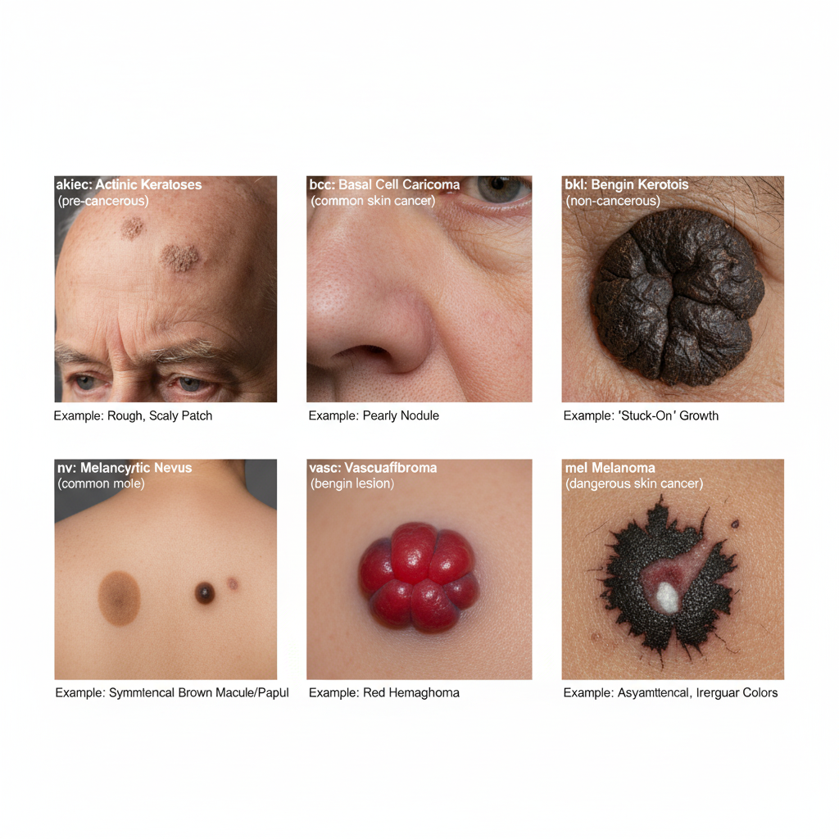


Slide 2

Department of Computer Science and Engineering
A Meta-Ensemble Deep Learning Approach Using EfficientFormerV2 and Swin Tiny Transformer for Skin Lesion Classification
PRESENTED BY
Yelchuri Siva Rama Krishna Vinay
Hari Lakshmi Sai Manikanta
Prajapathi Satyanarayana
(22471A05E0)
(22471A0595)
(22471A05C3)
Under the Guidance of,
Dr. Sireesha Moturi _{B.Tech, M.Tech.,Ph.D.,}
Associate Professor,
Department of Computer Science and Engineering,
Narasaraopeta Engineering College (Autonomous), Narasaraopet- 522 601.
Review No.
Department of CSE

Slide 3
OUTLINE
Abstract
Introduction
Literature Survey
Research Gaps
Problem Statement
Objectives
Block Diagram / Flow Diagram
Methodology
Implementation
Results and Analysis
Conclusion & Future Scope
References
Question and Answers
Acknowledgements
Review No.
Department of CSE

Slide 4
ABSTRACT
Timely recognition of skin cancers improves survival chances, yet automated diagnosis is hindered by subtle lesion similarities and uneven class distributions. This study proposes a dual-stream ensemble that integrates EfficientFormerV2 with the Swin Tiny Transformer for multiclass dermoscopic classification using the HAM10000 dataset. Both networks were pretrained on ImageNet and subsequently fine-tuned; their predictions were merged through two strategies: (1) probability-level fusion via weighted soft voting and (2) a meta-ensemble in which a logistic regression model learns from the concatenated logits of both backbones. Unlike earlier works that rely on a single CNN or transformer, this framework leverages the complementary strengths of a lightweight CNN–transformer hybrid and a hierarchical vision transformer.
Review No.
Department of CSE

Slide 5
ABSTRACT
Experiments show that the Swin Tiny model achieves the highest accuracy (∼90%), whereas the logistic-regression ensemble delivers the best balance across classes (macro F1 = 0.8800) and strong discrimination capability (ROC-AUC = 0.9814), with clear improvements on infrequentlesion types such as AKIEC and DF. We also assess inference cost and model size, highlighting EfficientFormerV2’s suitability for resource-limited deployment. While evaluation is restricted to HAM10000, future work will include cross-dataset studies and integration of clinical metadata. Overall, the proposed approach demonstrates potential as a reliable, scalable decision-support tool in dermatological practice.
Review No.
Department of CSE

Slide 6
INTRODUCTION
Skin cancer has become one of the fastest-growing cancers globally and is a major public health concern. According to the World Health Organization (WHO), more than 3 million non-melanoma and 132,000 melanoma skin cancer cases are reported every year. In recent global studies, the incidence of melanoma has increased by nearly 15% in the last decade, making early detection more important than ever. The American Cancer Society reports that the 5-year survival rate for melanoma is over 99% when detected at an early stage, highlighting the critical need for accurate diagnostic systems.Dermoscopic imaging is widely used by dermatologists to examine skin lesions, but interpretation can be challenging due to subtle visual differences among lesion types. With the growing number of cases and limited availability of specialists, there is a rising demand for automated and reliable diagnostic tools.Advances in deep learning have enabled significant improvements in medical image analysis.
Review No.
Department of CSE

Slide 7
INTRODUCTION
Modern architectures—such as Convolutional Neural Networks (CNNs) and Vision Transformers—have demonstrated strong ability in extracting meaningful patterns from dermoscopic images. These technologies help support clinicians by offering faster, more accurate, and consistent classification of skin lesions.This project focuses on developing a robust deep learning–based system that leverages both CNN and Transformer strengths for enhanced skin lesion classification. By integrating advanced feature extraction techniques and modern ensemble strategies, the model aims to support early detection, assist clinicians in decision-making, and contribute to improved patient outcomes in real-world dermatology and telemedicine environments.
Review No.
Department of CSE

Slide 8
LITERATURE SURVEY
No | Title | Author | Journal Name & Year | Methodology Adapted | Key Findings | Gaps
1 | A Large Dataset to Enhance Skin Cancer Classification With Transformer-Based Deep Neural Networks | M. Gallazzi et al. | https://dblp.org/rec/journals/access/GallazziBBGCG24 | Introduced a large-scale dermoscopic dataset and trained transformer-based classification models. | Achieved improved accuracy and robustness in lesion classification with transformer architectures. | Dataset remains imbalanced and training requires high computational resources.
2 | Multiclass Skin Lesion Classification in Dermoscopic Images Using Swin Transformer Model | S. Ayas | https://dl.acm.org/doi/abs/10.1007/s00521-022-08053-z | Applied Swin Transformer to classify multiple skin lesion categories using HAM10000 dataset. | Reached high classification performance surpassing CNN-based models. | Requires high GPU processing and lacks interpretability for clinical decision support.
3 | Addressing Challenges in Skin Cancer Diagnosis: A Convolutional Swin Transformer Approach | S. Paraddy and Virupakshappa, 2025 | https://pubmed.ncbi.nlm.nih.gov/39436477/ | Combined CNN feature extraction with Swin Transformer attention layers for diagnostic accuracy improvement. | Improved lesion texture recognition and reduced false positives. | Limited dataset scale and model not validated in real-world clinical settings.
Review No.
Department of CSE

Slide 9
LITERATURE SURVEY
No | Title | Author | Journal Name & Year | Methodology Adapted | Key Findings | Gaps
4 | An Image is Worth 16x16 Words: Vision Transformer for Image Recognition | A. Dosovitskiy et al. | https://arxiv.org/abs/2010.11929 | Introduced ViT that replaces CNN convolutions with transformer self-attention on image patches. | Demonstrated strong performance on large datasets, enabling transformer use in vision tasks. | Performs poorly on small medical datasets without pretraining and requires extensive computational resources.
5 | Swin Transformer: Hierarchical Vision Transformer Using Shifted Windows | Z. Liu et al. | https://arxiv.org/abs/2103.14030 | Developed hierarchical visual transformer with shifted window attention for efficient computation. | Achieved state-of-the-art performance on high-resolution image recognition tasks. | High memory usage and requires adaptation for domain-specific medical applications.
6 | EfficientNet: Rethinking Model Scaling for CNNs | M. Tan and Q. Le | https://arxiv.org/abs/1905.11946 | Proposed compound scaling strategy to optimize CNN architecture performance and efficiency. | Provided high accuracy with fewer parameters and lower computational costs. | Lacks global context learning and may underperform on complex lesion morphology.
Review No.
Department of CSE

Slide 10
LITERATURE SURVEY
No | Title | Author | Journal Name & Year | Methodology Adapted | Key Findings | Gaps
7 | EfficientFormerV2: Parameter-Efficient Vision Transformers | Y. Li et al. | https://arxiv.org/abs/2206.01191 | Designed lightweight transformer architecture suitable for efficient inference and mobile deployment. | Maintained strong performance while reducing parameter count and inference time. | Not tested extensively on dermoscopic datasets and may struggle with fine texture details.
8 | Hybrid Deep Learning Approaches for Skin Lesion Classification | M.A. Mohammed et al. | https://www.techscience.com/cmc/v65n2/38784 | Combined CNN deep feature extraction with SVM classifier for lesion diagnosis. | Improved melanoma detection rates and reduced false negatives. | Restricted to binary classification and lacks transformer-based advancements.
9 | Data-Efficient Deep Learning for Dermoscopy Image Analysis | E. Valle et al., 2020 | https://www.sciencedirect.com/science/article/pii/S0010482520303341 | Applied transfer learning and few-shot learning to reduce training data dependency. | Achieved strong accuracy using limited annotated samples. | Small dataset size restricted generalization; transformer-based techniques not explored.
10 | Transfer Learning Mechanics for Medical Imaging | M. Raghu et al., 2019 | https://papers.nips.cc/paper/2019/hash/35e7d8c0bfffc0e6c0f2a8a1e4b4915f-Abstract.html | Analyzed how pretrained visual models transfer knowledge to medical imaging tasks. | Clarified when and why transfer learning improves medical image model performance. | Domain mismatch and interpretability challenges persist in clinical usage.
Review No.
Department of CSE

Slide 11
RESEARCH GAPS
Most existing studies rely on either CNN or Transformer models, not a hybrid ensemble.
Rare lesion classes (e.g., AKIEC, DF) remain poorly detected due to dataset imbalance.
Limited research focuses on balanced performance metrics like Macro F1 and ROC-AUC.
Prior works emphasize accuracy but neglect deployment efficiency on low-resource devices.
Few models explore meta-learning or adaptive fusion between different architectures.
Lack of cross-dataset validation restricts generalization to real-world clinical settings.
Review No.
Department of CSE

Slide 12
PROBLEM STATEMENT
Accurate classification of skin lesions is challenging due to high visual similarity between benign and malignant types.
Existing CNN or Transformer models alone fail to maintain balanced accuracy, especially for rare lesion classes.
Class imbalance in datasets like HAM10000 leads to biased predictions toward common categories.
There is a lack of models that combine high accuracy, balanced performance, and computational efficiency.
The project aims to develop a hybrid meta-ensemble model that integrates EfficientFormerV2 and Swin Tiny Transformer.
This approach addresses both performance imbalance and deployment feasibility, ensuring reliable results for clinical use.
Review No.
Department of CSE

Slide 13
OBJECTIVES
To design a dual-stream ensemble model integrating EfficientFormerV2 and Swin Tiny Transformer for improved multiclass skin lesion classification accuracy and reliability.
To implement and compare two fusion strategies, Weighted Soft Voting and Logistic Regression Meta-Ensemble, for adaptive and balanced prediction across all lesion categories.
To evaluate the model using key performance metrics such as Accuracy, Macro F1-score, and ROC-AUC to ensure robustness under class imbalance conditions.
To develop a lightweight and computationally efficient framework suitable for real-time deployment in clinical and teledermatology environments.
Review No.
Department of CSE

Slide 14
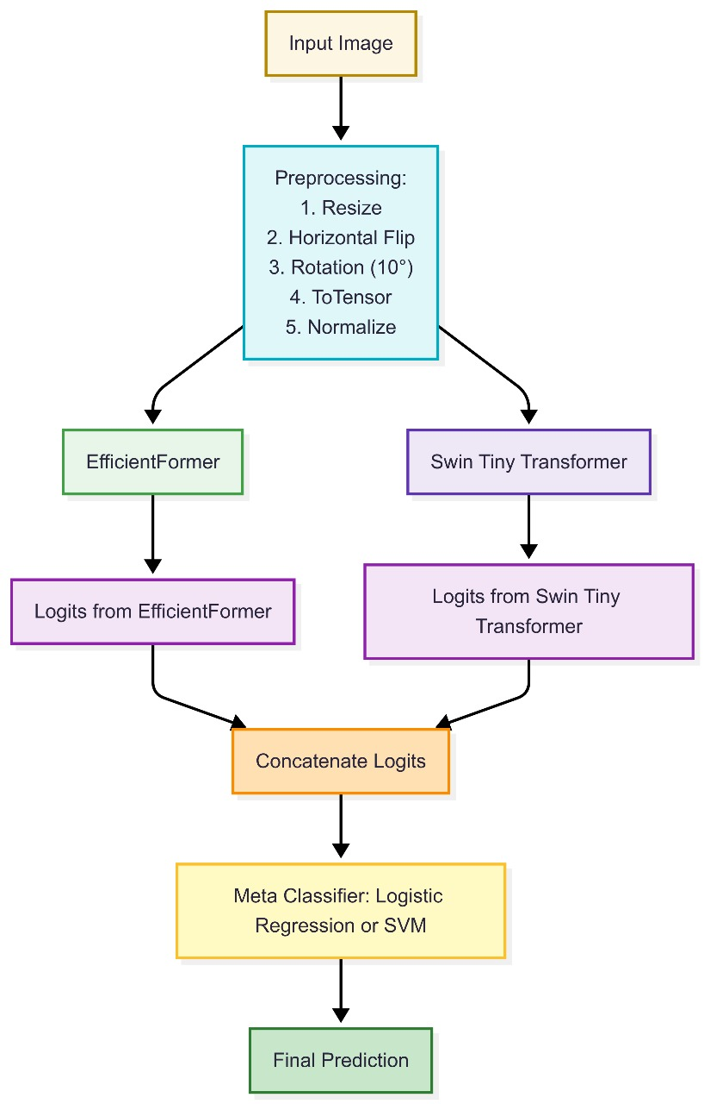
FLOW DIAGRAM
Review No.
Department of CSE

Slide 15
METHODOLOGY
Dataset Preparation: Used the HAM10000 dataset with 10,015 dermoscopic images categorized into seven lesion classes, resized and augmented through rotations, flips, normalization, and tensor conversion.
Backbone Models: Employed two pretrained architectures — EfficientFormerV2 for lightweight and efficient feature extraction, and Swin Tiny Transformer for hierarchical global–local feature representation.
Training Configuration: Both models fine-tuned using the Adam optimizer (lr = 1×10⁻⁴), categorical cross-entropy loss, batch size 32, and 20 epochs with early stopping to prevent overfitting.
Review No.
Department of CSE

Slide 16
METHODOLOGY
Soft Voting Ensemble: Combined prediction probabilities of both models using ( P_{final} = \alpha P_E + (1 - \alpha) P_S ) with α = 0.5 for balanced fusion.
Logistic Regression Meta-Ensemble: Trained a logistic regression classifier on concatenated logits ([z_E; z_S]) to adaptively weight model outputs and enhance rare-class detection.
Implementation Tools: Training performed on Google Colab (Tesla T4 GPU, 16GB VRAM) using PyTorch, ensuring efficient computation and stable convergence.
Review No.
Department of CSE

Slide 17
How we Addressed Class Imbalance
Data Augmentation (Targeted)
Applied stronger augmentation for minority classes.
Increased variety using rotation, flipping, zoom, and color jitter.
Improved learning of rare lesion patterns.
Class-Balanced Sampling
Used a weighted sampler during training.
Ensured each batch contained proportionate samples from all classes.
Weighted Loss Function
Assigned higher weights to rare classes.
Penalized misclassification more strongly for minority categories.
Review No.
Department of CSE

Slide 18
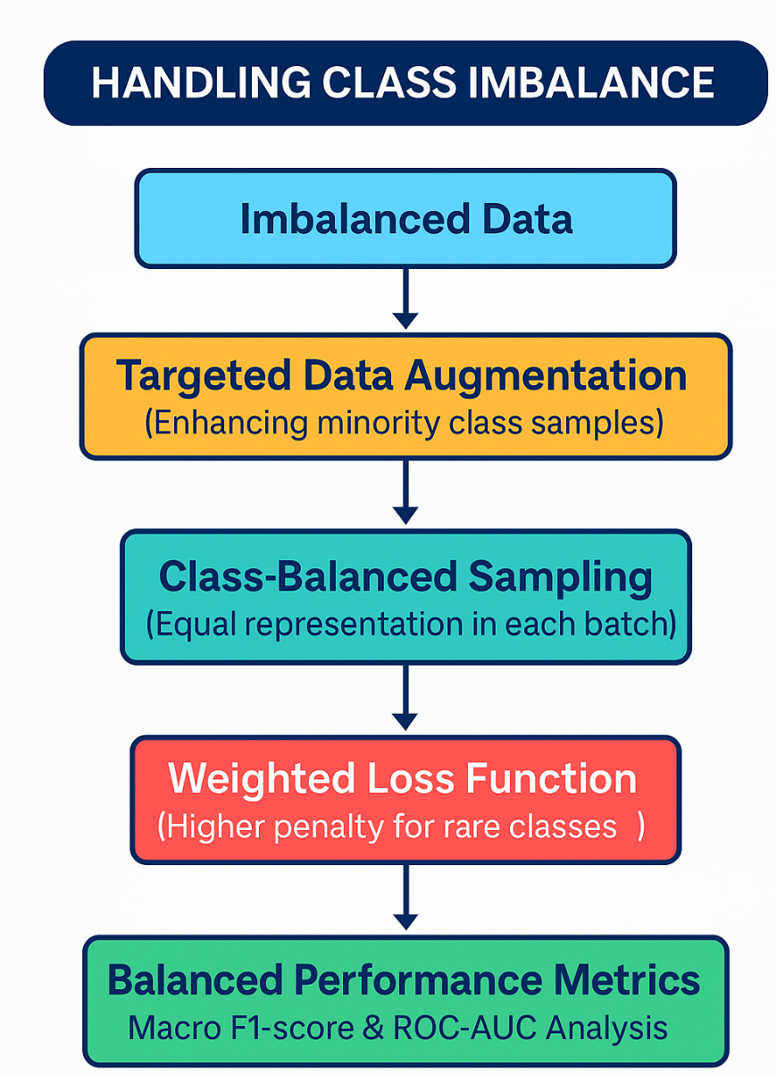
How we Addressed Class Imbalance
Meta-Ensemble Fusion
Combined model outputs using a Logistic Regression layer.
Reduced individual model biases and improved rare-class detection
Balanced Evaluation Metrics.
Used Macro F1-score and ROC-AUC.
Ensured fair performance across all seven lesion classes
Review No.
Department of CSE

Slide 19
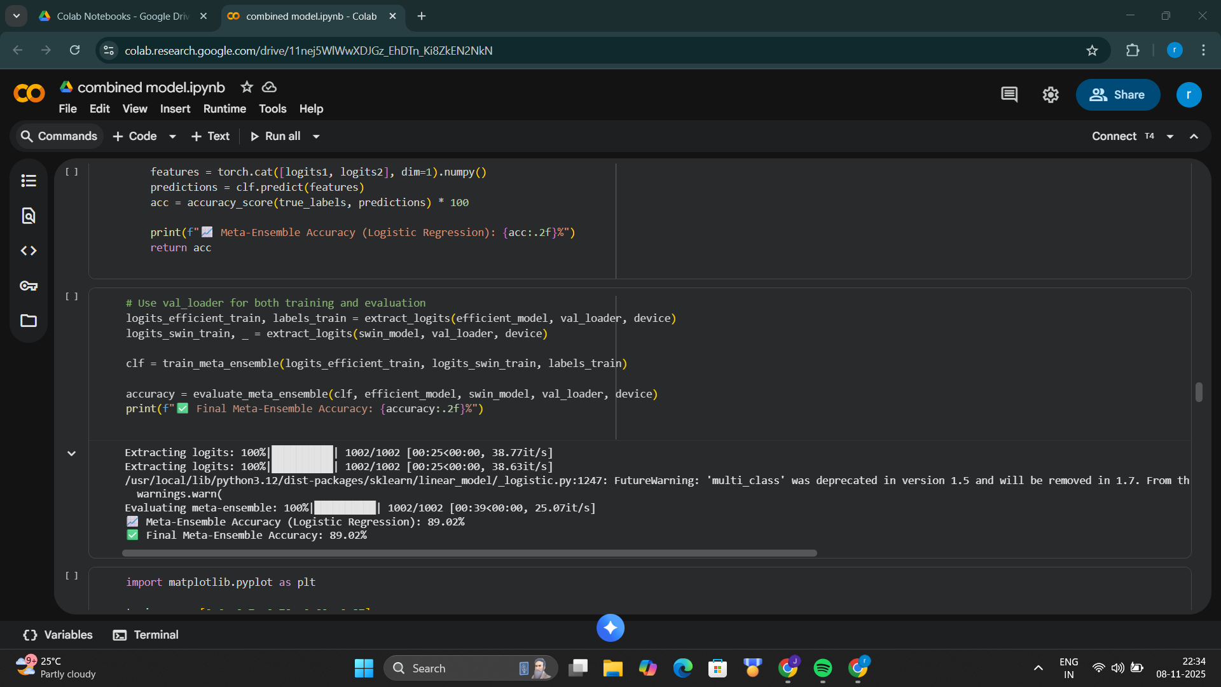
IMPLEMENTATION
Review No.
Department of CSE

Slide 20
IMPLEMENTATION
Software Specifications: Implemented using Python, PyTorch, and scikit-learn frameworks; additional tools included NumPy, Matplotlib, and Google Colab environment for training and visualization.
Hardware Specifications: Model training executed on Google Colab GPU runtime using an NVIDIA Tesla T4 (16GB VRAM), ensuring efficient computation and reduced training time.
Model Training: Both EfficientFormerV2 and Swin Tiny Transformer were fine-tuned on the HAM10000 dataset with ImageNet pretrained weights, Adam optimizer (lr = 1×10⁻⁴), and batch size = 32.
Review No.
Department of CSE

Slide 21
IMPLEMENTATION
Ensemble Implementation: Combined model predictions using Soft Voting and Logistic Regression Meta-Ensemble, improving overall class balance and performance on rare lesion types.
Challenges Faced: Faced class imbalance and overfitting during training; addressed using data augmentation, early stopping, and adaptive learning rate scheduling.
Outcome: Achieved Macro F1 = 0.8800 and ROC-AUC = 0.9814, demonstrating strong accuracy, stable convergence, and suitability for real-world deployment.
Review No.
Department of CSE

Slide 22
RESULTS & ANALYSIS
Method | Accuracy (%) | Macro F1 | ROC-AUC
EfficientFormer V2 | 89.77 | 0.8295 | 0.964
Swin Tiny Transformer | 90.01 | 0.8396 | 0.986
Meta-Ensemble (LogReg) | 89.02 | 0.8800 | 0.9814
The paper's focus on Macro F1 (which balances precision and recall across all classes) and ROC-AUC emphasizes the models' performance in handling the class imbalance and providing balanced classification, which is more clinically meaningful than accuracy alone. While the individual Precision and Recall values are not included in the tables, the high Macro F1-score of the Meta-Ensemble (0.8800) indicates strong performance in both metrics
Review No.
Department of CSE

Slide 23
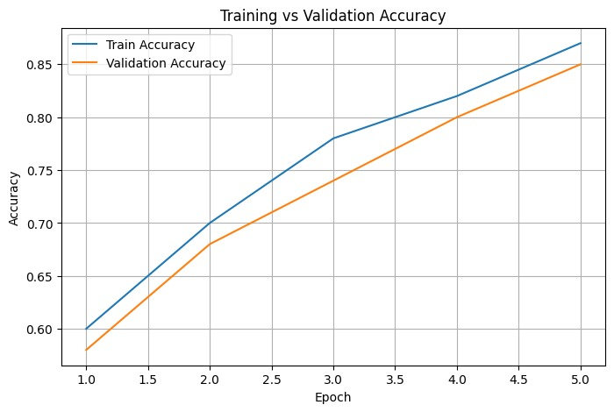
RESULTS & ANALYSIS
Accuracy improved steadily over epochs.
The close alignment between training and validation curves indicates effective generalization and minimal overfitting.
Review No.
Department of CSE

Slide 24
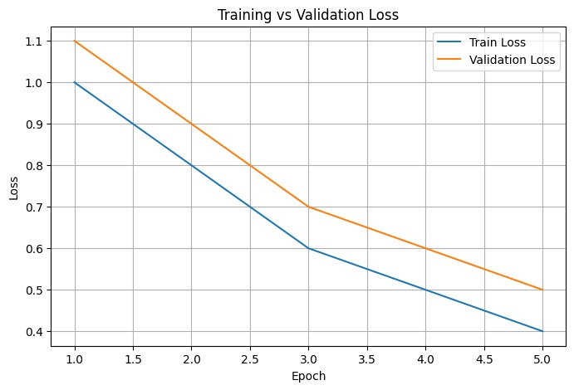
RESULTS & ANALYSIS
Training and validation losses decreased consistently across epochs.
The consistent convergence without divergence demonstrates stable learning and absence of overfitting
Review No.
Department of CSE

Slide 25
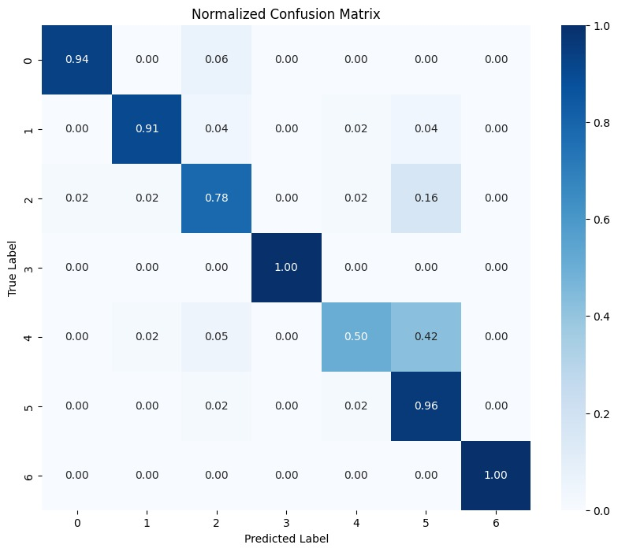
RESULTS & ANALYSIS
The matrix confirms strong classification for most lesions (e.g., DF and VASC at 1.00).
The meta-ensemble reduces confusion, notably between visually similar classes like melanoma (MEL) and benign keratosis (BKL).
The primary misclassification is melanoma (MEL, True Label 4) being predicted as benign nevi (NV, Predicted Label 5) at 42%.
Review No.
Department of CSE

Slide 26
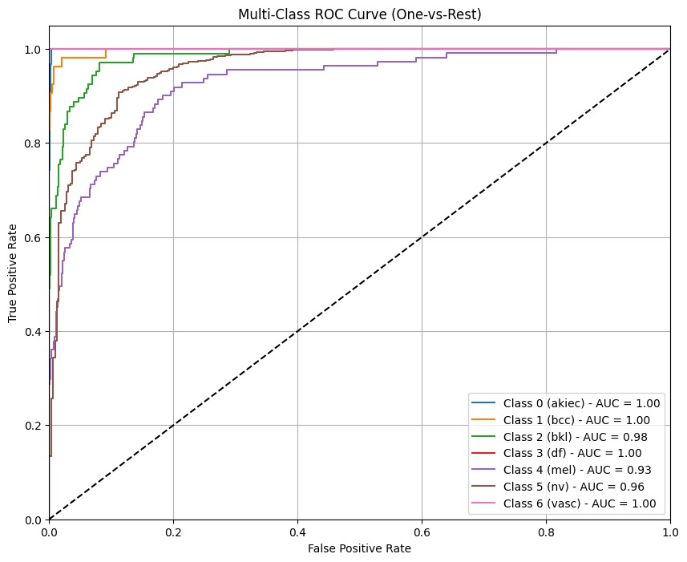
RESULTS & ANALYSIS
The curve confirms strong discriminative performance for most classes, with five out of seven classes achieving a perfect AUC of 1.00 (AKIEC, BCC, DF, VASC).
Class 2 (BKL) shows a very strong AUC of 0.98, indicating excellent separation from the rest of the classes.
Class 4 (MEL - Melanoma) and Class 5 (NV - Nevi) are the most challenging, with AUCs of 0.93 and 0.96, respectively, yet these still represent strong classification capability.
Review No.
Department of CSE

Slide 27
CONCLUSION and FUTURE SCOPE
The proposed meta-ensemble effectively integrates EfficientFormerV2 and Swin Tiny Transformer for balanced skin lesion classification.
Achieved high performance with a Macro F1-score of 0.8800 and ROC-AUC value of 0.9814.
Combines lightweight CNN and Transformer features, ensuring robust and accurate classification across all lesion categories.
Demonstrates strong potential for real-time deployment in teledermatology and clinical diagnostic support systems.
Limitation includes reliance on a single dataset and absence of clinical metadata integration for broader validation.
Future improvements include testing on larger datasets, adding metadata, and applying Grad-CAM for interpretability.
Review No.
Department of CSE

Slide 28
REFERENCES
M. Gallazzi, S. Biavaschi, A. Bulgheroni, T. M. Gatti, S. Corchs, and I. Gallo, “A Large Dataset to Enhance Skin Cancer Classification With Transformer-Based Deep Neural Networks,” Department of Theoretical and Applied Science, University of Insubria, Varese, Italy, 2025.
A. Esteva et al., “Dermatologist-level skin cancer classification with deep neural networks,” Nature, vol. 542, pp. 115–118, 2017.
Z. Liu et al., “Swin Transformer: Hierarchical Vision Transformer using shifted windows,” IEEE ICCV, pp. 10012–10022, 2021.
Y. Li et al., “EfficientFormerV2: Parameter-efficient vision transformers,” arXiv preprint arXiv:2206.01191, 2022.
S. Ayas, “Multiclass skin lesion classification in dermoscopic images using Swin Transformer model,” Neural Computing and Applications, vol. 35, no. 9, pp. 6713–6722, 2023.
Review No.
Department of CSE

Slide 29
REFERENCES
S. Paraddy and V. Virupakshappa, “Addressing challenges in skin cancer diagnosis: A convolutional Swin Transformer approach,” Journal of Imaging Informatics in Medicine, vol. 38, no. 3, pp. 1755–1775, 2025.
K. He, X. Zhang, S. Ren, and J. Sun, “Deep residual learning for image recognition,” IEEE CVPR, pp. 770–778, 2016.
O. Ronneberger, P. Fischer, and T. Brox, “U-Net: Convolutional networks for biomedical image segmentation,” MICCAI, pp. 234–241, 2015.
M. Tan and Q. Le, “EfficientNet: Rethinking model scaling for convolutional neural networks,” ICML, pp. 6105–6114, 2019.
T. J. Brinker et al., “Artificial intelligence applications in dermatology: Survey and perspectives,” Journal of the European Academy of Dermatology and Venereology, vol. 33, no. 10, pp. 1776–1784, 2019.
Review No.
Department of CSE

Slide 30
REFERENCES
M. A. Mohammed et al., “Hybrid deep learning approaches for skin lesion classification,” Computers, Materials & Continua, vol. 65, no. 2, pp. 1179–1194, 2020.
S. S. Han et al., “Deep learning in differentiation of benign and malignant skin tumors,” Journal of Investigative Dermatology, vol. 138, no. 7, pp. 1529–1538, 2018.
E. Valle et al., “Data-efficient deep learning for dermoscopy image analysis,” Computers in Biology and Medicine, vol. 118, Article 103636, 2020.
M. Raghu et al., “Transfer learning mechanics for medical imaging,” NeurIPS, pp. 3342–3352, 2019.
R. B. Fisher, J. Rees, and A. Bertrand, “Hierarchical KNN vs deep networks for classification of skin lesions,” Medical Image Understanding and Analysis, Springer, vol. 1065, pp. 55–66, 2020.
Review No.
Department of CSE

Slide 31

Review No.
Department of CSE

Slide 32
ACKNOWLEGEMENTS
Grateful to the college management and project guide for their constant guidance and encouragement.
Thanks to all team members and faculty for their valuable support and technical assistance.
Sincere appreciation to the conference committee for the opportunity to present this research work.
For further inquiries, contact:
sireeshamoturi@gmail.com
yelchurivinay28@gmail.com
mani.77.manikanta@gmail.com
satyanarayanaprajapathi1@gmail.com
Review No.
Department of CSE

Slide 33

Review No.
Department of CSE

